Slide 1
Realist review of dementia friendly society and social participation
Neil Chadborn
Notes:
My part in this project is to give method expertise for realist review, as well as contribute some hours to the search and analysis work.

Slide 2
Dementia-friendly or united?
Drawing on Claire Goodman and colleagues’ work in DEMCOM evaluation of national dementia-friendly communities project in England:
Are dementia-friendly communities about:
Raising (public) awareness and tackling stigma
A rights-based approach to inclusive communities
Community Engagement Evidence Synthesis : A final report for Alzheimer’s Society. / Buswell, Marina; Goodman, Claire; Russell, Bridget; Bunn, Frances; Mayrhofer, Andrea; Goodman, Ellen.
University of Hertfordshire, 2017. Commissioned report
http://researchprofiles.herts.ac.uk/portal/en/publications/community-engagement-evidence-synthesis(688d4177-4c35-4d0a-8069-e56427190a7c)/export.html
Notes:
I am also working with Claire Goodman, University of Hertfordshire, on another realist project – so I am learning a lot from her in terms of methods.
Claire is leading DEMCOM project and has published a review about dementia friendly communities, which started by asking ‘what are they about’ – identifying disparate aims – awareness raising, or promoting a rights-based approach

Slide 3
Petals of the Forget-me-not Bloemblaadjes van Vergeet-mij-niet
Social Participation
DFS
Community support & health services
Respect and social inclusion
But how do we differentiate between participation and inclusion?
Civic participation and employment
Notes:
They started with the WHO Age-friendly work - with recent work based in Liverpool; Nigel Bruce, Dan Pope, Sara Ronzi et al. I have taken this flower diagram to highlight social participation, social inclusion and civic participation. Do we (should we) differentiate between these topics?
For dementia friendly – the flower turns into a forget-me-not and this is same in Netherlands – eg this project which our colleagues (Frans Lemmers) are involved in in Roermond

Slide 4
Social participation, social inclusion...
@nchadborn
#Alzchat Sorry to chip in late- I was discussing this today with Dutch colleagues: is there a difference between social participation and social inclusion, and is social isolation simply the opposite of both of these? Would appreciate input from y'all?! @IRememberBetter
@HelenFindlay
@nchadborn @IRememberBetter It is possible to feel isolated in a room full of people so I would suggest that inclusion not solely about going to things but also how assimilated when there #AlzChat
@Tommytommytee18
People with dementia want to stay supported in their own homes and communities, but let’s be clear having family round you does not prevent isolation if they do not fully engage with you
@KarrieMarshall
would say participation is the act of participating and inclusion is the attitude/ system/ means that enables the participation ? Also exclusion usually regarded as opposite of Inclusion, where as social isolation is not always about exclusion... #AlzChat https://t.co/xCJRjg4d5v
@YODsupporter
@nchadborn @IRememberBetter Social participation to me is the "doing", eg PLWD participate socially. Social inclusion is the policy framework, eg PLWD are citizens living w disabilities, who may be indigenous, Italian, Sudanese, LBTQI, living in remote areas, of all ages, etc - crossovers matter. #AlzChat
Notes:
I wondered what ‘the public’ thought about these terms, and so asked a question on twitter during a dementia ‘tweetchat’ – fascinating and expert responses (one is a health professional I think – others carers or people with dementia).
An important point is that ‘participation’ is more linked to an activity. ‘Inclusion’ may be a policy aim, or an outcome (eg. to be measured). Some (other) comments said they the terms mean the same. Others differentiate – eg social isolation not always about exclusion.
This may mirror ‘loneliness’ debate – you can choose, or be content with, being isolated – whereas loneliness is a negative emotion

Slide 5
Integrating ‘bodies of knowledge’
We may find that information or evidence is located within three ‘bodies of knowledge’:
Policy-making
Community-based:
peer-support, circles of support, dementia cafés
Occupational therapy practice & interventions
Different types of evidence; population or person or community
Notes:
It is important to discuss word meanings, because often words mean different things to different professions. Evidence of scientific literature is generally developed within professional/academic disciplines, and words in one discipline can have a different meaning in a different discipline.
I anticipate that Mentality will have an interest which overlaps professional practice and community-based work. It will be shaped by policy, and I’m not sure to what extent Mentality is interested in the question of policy development and implementation (or whether this will given as a background)?

Slide 6
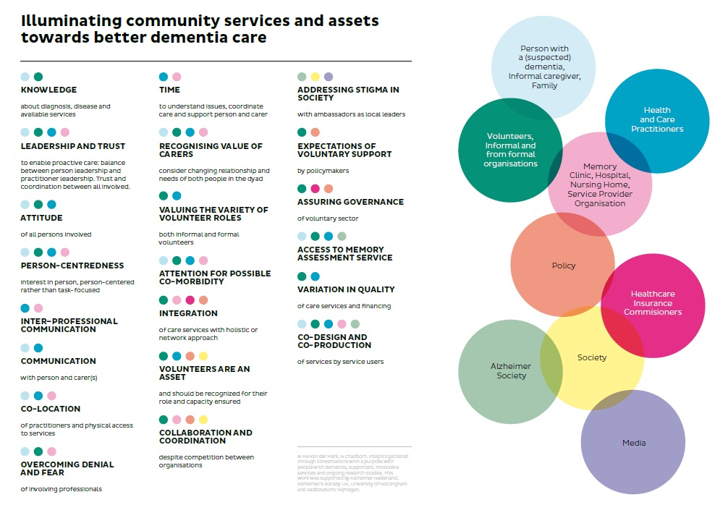
Exploring complexity of community support
Notes:
As an example, Marjolein van der Marck and myself, in a fellowship funded by Alzheimer’s Society (UK) and Alzheimer Nederland described the complexity of relationships between many different ‘actors’ in community: person with dementia and care partner, third sector, health and welfare services

Slide 7
Realist causal mechanisms
Context
Mechanism
Outcome
If practitioner can give navigational aids
Then person with dementia can travel to community resources
Notes:
We will undoubtedly be able to find a huge diversity of literature on dementia friendly society and social participation. We will select and interpret this using realist review (synthesis) method. This aims to describe the causal mechanisms whereby a ‘programme’ can bring about outcomes. This is a sociological approach, so it’s helpful to think about how social mechanisms can bring about social outcome. The method ‘embraces complexity’ and emphasises the social context – mechanisms can only ‘fire’ (bring about positive outcomes) if they are in an appropriate context.
The starting point of this work, is to listen to experts such as yourselves, and try to identify causal processes – and we can start with some simple ‘If… then…’ statements. So If a practitioner can help a person with dementia with navigational aids.. Then that person can travel to community resources (this is one I’ve just made up).
We will then take these ideas to the literature and see if we can find articles which support (or refute) these proposals.
We have already conducted two literature searches; one on social participation and dementia, and the other on dementia friendly society

Slide 8
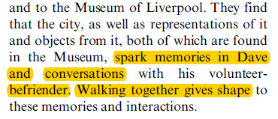
Initial thoughts on programme theory based on one qualitative study
Memories and conversation as outcome?
Voluntary relationship, and ‘role’ of befriender – supports the mechanism
Mechanism is walking together – giving shape to memories and relationship
We can start to describe a CMO configuration called 'befriending practices'. This would fit within the 'community-based' body of knowledge - i.e. not involving professional knowledge or policy (directly)
Notes:
So it’s good to work from professional opinion and public and stakeholder (end-user) input, and we will start to do that at the meeting on Tuesday, but to give an example of this approach, here’s an article I’ve just analysed with this in mind. This is just one paragraph which gives hints about mechanism and outcome.

Slide 9
Aim of Realist Review
Develop ‘demi-regularities’ = context dependent theories which are transferrable
NB avoid positivist words like objective, generalisable, or laws/rules
Empirical = observable : documents, data
Actual = protocols and ideas about ‘how’ these work (in practice)
Real = non-observable theories about ‘causal powers’ : how or why does social change happen
Social theory
Other discipline theory
aka ‘mid-range’ theory
Notes:
Realist review & evaluation is based on a layered ontology (theory of reality) where our empirical (everyday perceptions or measurable observations) emerge from actual events and programmes. These activities are caused by mechanisms in the real layer. Another way of describing is that realist evaluation summarises many different programme theories – real mechanisms are ‘mid-range theories’ or demi-regularities which hold true across multiple programmes, but are by no means ‘grant theories’ or ‘universal truths’.

Slide 10
Different types of theory in realist review
Copied from Wong et al
Substantive theory (domain /discipline)
Philosophical; ontology and epistemology
Program theory (theory of action & change)
Research / evaluation theory (paradigm/approach or model)
?
Notes:
The words theory and model are used in different senses and this maps out how these theories inform each other. Substantive theory is drawn from professional body of knowledge (see orange circle in slide 5)

Slide 11
Development of CMO theory
Interviews with experts in project
Initial idea statements
“if... then...”
Context
Mechanism
Outcome
Research articles
Social theories
Notes:
This is my conception of tasks within realist review – firstly consultation of ‘context expert group’ (Mentality advisory group) and reflect on literature searches to define scope, secondly develop initial programme theories in the sense of “If… happens, then…. Follows”. I think it is helpful to consider how social theories may give additional ‘robustness’ to these theories, in developing CMO configuration

Slide 12
Flow
Stage 1 – scoping – If… then….
Stage 2 – testing and refining CMO configurations
Stage 3 – analysis of CMOs
Initial rough theory
Theory of Action
Theory of Change
Review of evidence
Evidence about…
Specific program elements
Implementation
Outcomes
How mechanisms generate outcomes
How context affects mechanisms and outcomes
Refined theory
CMO1
CMO2
CMO3
Etc
Explanation of pattern of CMOs
From Wong, Westthorp, Pawson and Greenhalgh 2013 Realist Synthesis
Notes:
The next stage is to develop and refine CMO based on data extracted from literature articles. The third stage is to reflect on the extent to which we can demonstrate that evidence supports CMO theory (or refutes). Finally there should be an explanation of the pattern of CMOs – why are there several – are these triggered by different contexts? Is there a nested (sequential) pattern of CMOs eg CMO1 is about training staff, CMO2 starts from ‘better trained staff’ (context) and the outcome is improved person-centred care. Similarly a city-wide initiative may not have a direct outcome of benefitting citizens, but may create the context for activities which do lead to direct benefits.

Slide 13
RAMESES Reporting guidelines
TITLE
1 |  | In the title, identify the document as a realist synthesis or review
ABSTRACT
2 |  | While acknowledging publication requirements and house style, abstracts should ideally contain brief details of: the study's background, review question or objectives; search strategy; methods of selection, appraisal, analysis and synthesis of sources; main results; and implications for practice.
INTRODUCTION
3 | Rationale for review | Explain why the review is needed and what it is likely to contribute to existing understanding of the topic area.
4 | Objectives and focus of review | State the objective(s) of the review and/or the review question(s). Define and provide a rationale for the focus of the review.
METHODS
5 | Changes in the review process | Any changes made to the review process that was initially planned should be briefly described and justified.
6 | Rationale for using realist synthesis | Explain why realist synthesis was considered the most appropriate method to use.
7 | Scoping the literature | Describe and justify the initial process of exploratory scoping of the literature.
8 | Searching processes | Provide a rationale for how the iterative searching was done. Where searching in electronic databases has taken place, the details should include, for example, name of database, search terms, dates of coverage and date last searched. If individuals familiar with the relevant literature and/or topic area were contacted, indicate how they were identified and selected.
9 | Selection and appraisal of documents | Explain how judgements were made about including and excluding data from documents, and justify these.
10 | Data extraction | Describe and explain which data or information were extracted from the included documents and justify this selection.
11 | Analysis and synthesis processes | Describe the analysis and synthesis processes in detail. This section should include information on the constructs analyzed and describe the analytic process.
RESULTS
12 | Document flow diagram | Provide details on the number of documents assessed for eligibility and included in the review with reasons for exclusion at each stage as well as an indication of their source of origin (for example, from searching databases, reference lists and so on). You may consider using the example templates (which are likely to need modification to suit the data) that are provided.
13 | Document characteristics | Provide information on the characteristics of the documents included in the review.
14 | Main findings | Present the key findings with a specific focus on theory building and testing.
DISCUSSION
15 | Summary of findings | Summarize the main findings, taking into account the review's objective(s), research question(s), focus and intended audience(s).
16 | Strengths, limitations and future research directions | Discuss both the strengths of the review and its limitations. These should include (but need not be restricted to) (a) consideration of all the steps in the review process and (b) comment on the overall strength of evidence supporting the explanatory insights which emerged.
 |  | The limitations identified may point to areas where further work is needed.
17 | Comparison with existing literature | Where applicable, compare and contrast the review's findings with the existing literature (for example, other reviews) on the same topic.
18 | Conclusion and recommendations | List the main implications of the findings and place these in the context of other relevant literature. If appropriate, offer recommendations for policy and practice.
19 | Funding | Provide details of funding source (if any) for the review, the role played by the funder (if any) and any conflicts of interests of the reviewers.
Notes:
If we follow RAMESES guidelines for realist review, we will be able to check the boxes – which should lead to publication.

Slide 14
Thanks for listening, please contact me for any questions:
Neil.Chadborn@nottingham.ac.uk
@nchadborn

